Slide 1


Topic Heart Disease Prediction using Machine Learning Algorithm
19BIO201 INTELLIGENCE OF BIOLOGICAL SYSTEMS - 3

Slide 2

Team - 16
UTHEJ K
BL.EN.U4AIE20023
K GURUNADH
BL.EN.U4AIE20030
K GURUNADH
BL.EN.U4AIE20030
NIKHIL KUMAR M
BL.EN.U4AIE20043

Slide 3
Introduction
Heart diseases or Cardiovascular Diseases (CVDs) are the main reason for a huge number of deaths in the world over the last few decades and has emerged as the most dangerous disease
An estimated 17.9 million people died from CVDs in 2019, representing 32% of all global deaths. Of these deaths, 85% were due to heart attack and stroke.
Over three quarters of CVD deaths take place in low- and middle-income countries.
Out of the 17 million premature deaths (under the age of 70) due to noncommunicable diseases in 2019, 38% were caused by CVDs.

Slide 4

Most cardiovascular diseases can be prevented by addressing behavioral risk factors such as tobacco use, unhealthy diet and obesity, physical inactivity and harmful use of alcohol.
It is important to detect cardiovascular disease as early as possible so that management with counselling and medicines can begin.
Heart attacks and strokes are usually acute events and are mainly caused by a blockage that prevents blood from flowing to the heart or brain.
The most common reason for this is a build-up of fatty deposits on the inner walls of the blood vessels that supply the heart or brain.

Slide 5
Main Risk factors for cardiovascular disease
High blood pressure
Smoking
High cholesterol
Diabetes
Inactivity
Being overweight or obese

Slide 6
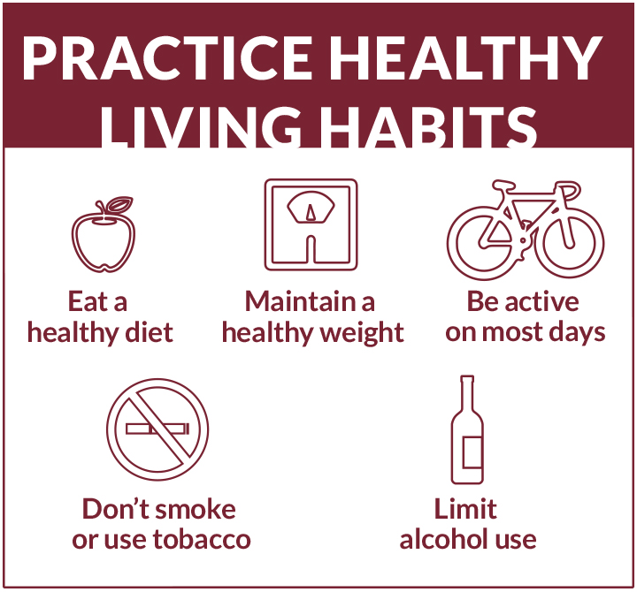
Preventing cardiovascular disease
Stop smoking
Have a balanced diet
Exercise regularly
Maintain a healthy weight
Cut down on alcohol
Medication
01
02
03
04
05
06

Slide 7
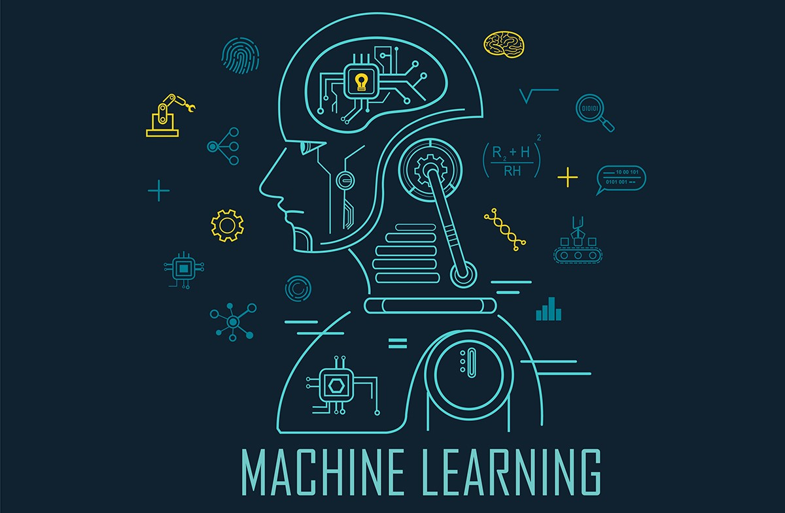
Algorithm
Machine learning disease prediction is a system that predicts diseases based on information provided by user
Machine Learning algorithms are very useful in various medical datasets to automate the analysis of large and complex data
It predicts the disease of the patient based on the information or the symptoms entered by user and gives results based on that information or symptoms

Slide 8
Algorithm
This Machine learning disease predictor gives the idea and tips to take care of the health of the user. And it also provides how to seek out disease using this prediction
We have done this Heart Disease Prediction Using Machine Learning with the help of Machine Learning algorithms and Python Programming.
Here for prediction of heart diseases we used logistic regression

Slide 9
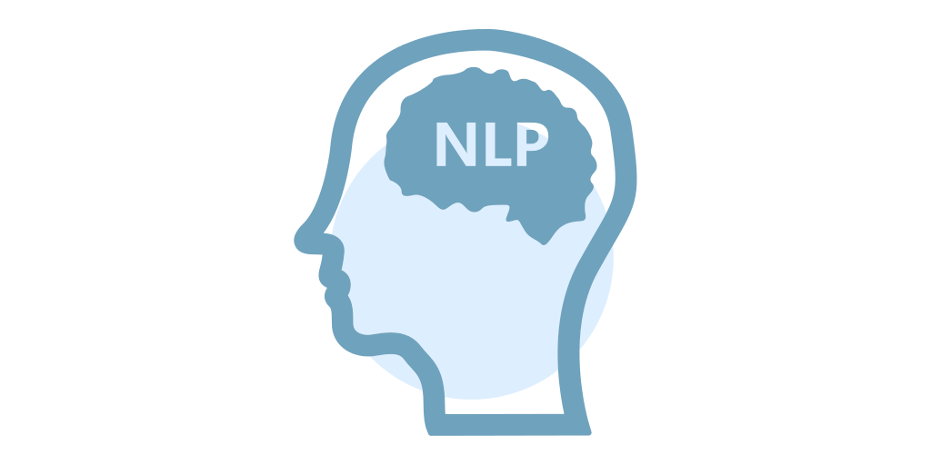



Algorithms Used
SVM
K-NN
Support Vector Machine
K Nearest Neighbors
LR
RF
Logistic Regression
Random Forest

Slide 10
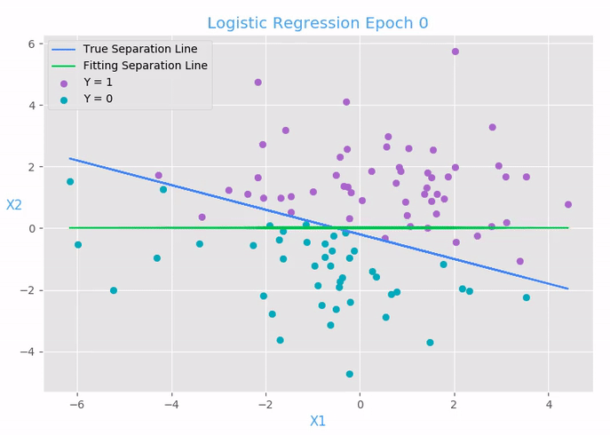
LR
Logistic Regression(LR) is a statistical and machine learning technique
It predicts a dependent variable based on one or more set of independent variables to predict outcomes.

Slide 11
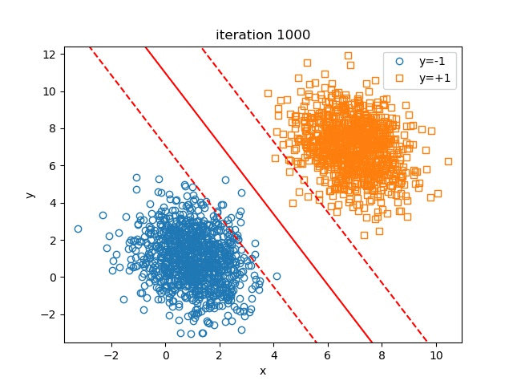
SVM
Support Vector Machine(SVM) is a supervised machine learning algorithm used for both classification and regression.
SVM works by mapping data to a high-dimensional feature space so that data points can be categorized, even when the data are not otherwise linearly separable

Slide 12
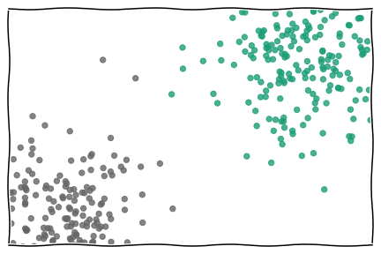
K-NN
K-Nearest Neighbor (K-NN) Is a Supervised Learner for Both Classification and Regression.
KNN algorithms decide a number k which is the nearest Neighbor to that data point that is to be classified.

Slide 13
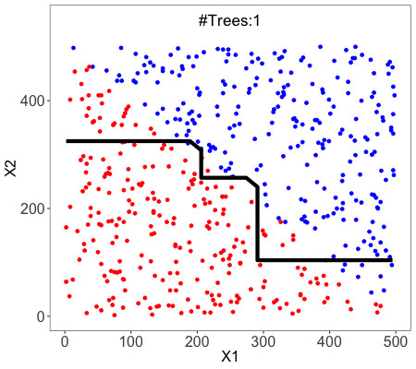
RF
Random forests (RF) or random decision forest is an ensemble learning method for classification, regression and other tasks
The algorithm operates by constructing a multitude of decision trees at training time and outputting the mean/mode of prediction of the individual trees.

Slide 14
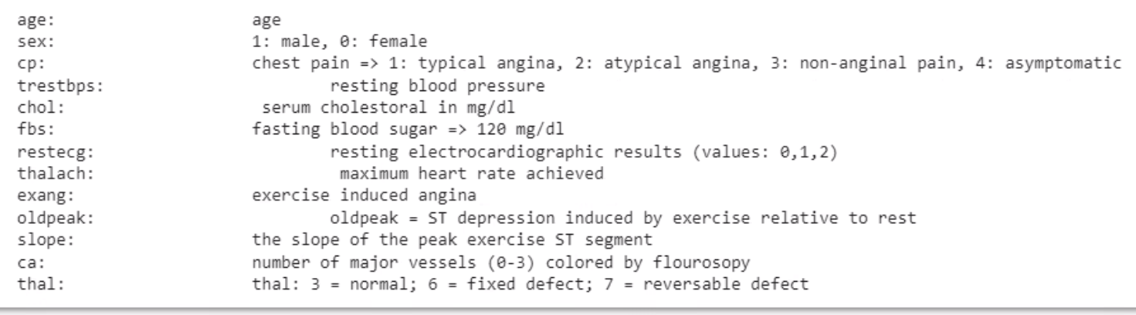
Data used
We have used the dataset that's available in Kaggle

Slide 15
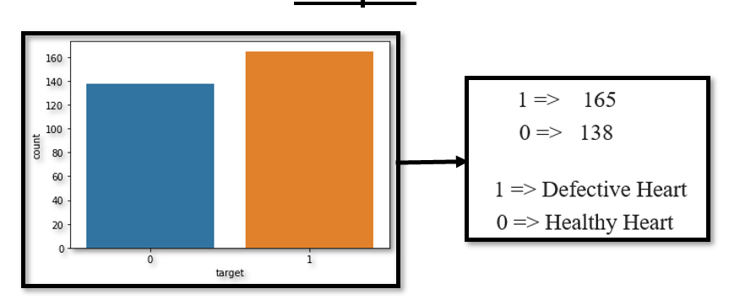
Output

Slide 16
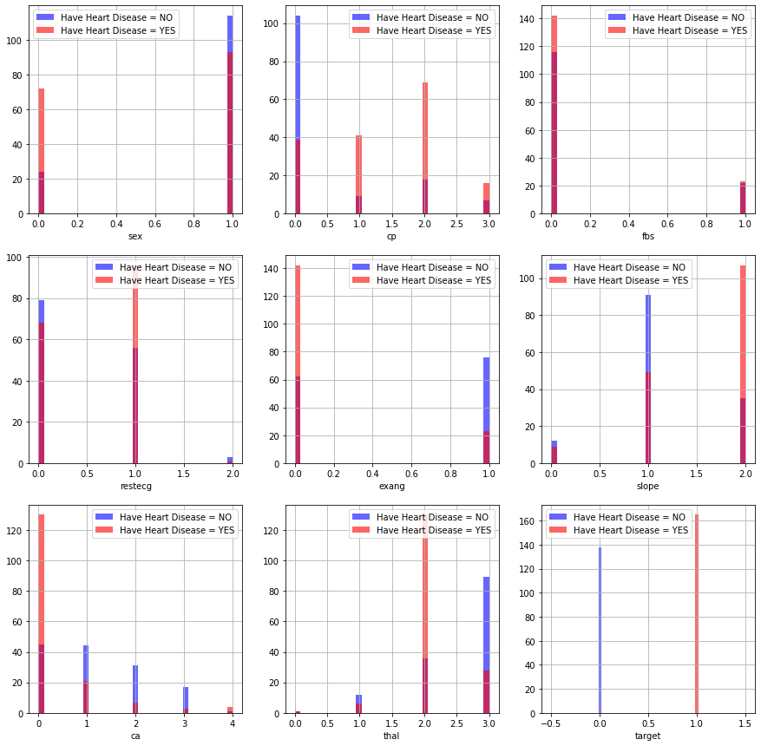

Slide 17
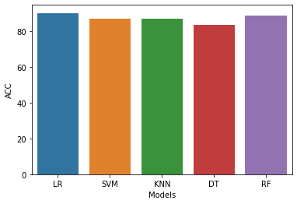
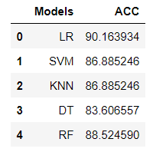
Accuracy Comparison

Slide 18

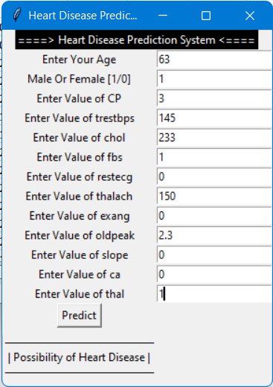
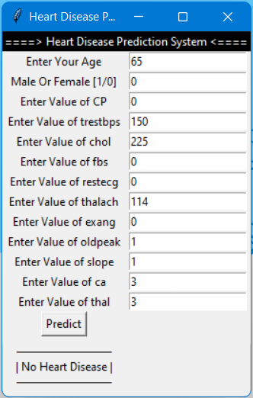
GUI Output

Slide 19

Conclusion
This project gives the profound understanding into ML procedures for characterization of heart diseases. The job of classifier is essential in medical care industry so the outcomes can be utilized for anticipating the therapy which can be given to patients. The current procedures are read up and looked at for tracking down the proficient and precise frameworks

Slide 20
References
Atharv Nikam, Sanket Bhandari, Aditya Mhaske, “Cardiovascular Disease Prediction Using Machine Learning Models”, 2020 IEEE Pune Section International Conference
Nilam Harkulkar, Swati Nadkarni, Dr. Bhavesh Patel, “Heart Disease Prediction using CNN, Deep Learning Model ”, International Journal for Research in Applied Science & Engineering Technology (IJRASET)
Dr. M. Kavitha, G. Gnaneswar, R. Dinesh, Y. Rohith Sai, R. Sai Suraj, “Heart Disease Prediction using Hybrid machine Learning Model ”, Proceedings of the Sixth International Conference on Inventive Computation Technologies [ICICT 2021] IEEE Xplore Part Number: CFP21F70-ART; ISBN: 978-1-7281-8501-9
Sunitha Guruprasad, Valesh Levin Mathias, Winslet Dcunha , “Heart Disease Prediction Using Machine Learning Techniques”, 2021 5th International Conference on Electrical, Electronics, Communication, Computer Technologies and Optimization Techniques (ICEECCOT) 10-11, December 2021
Vijeta Sharma, Shrinkhala Yadav, Manjari Gupta,“Heart Disease Prediction using Machine Learning Techniques”, 2020 2nd International Conference on Advances in Computing, Communication Control and Networking (ICACCCN)
Yu Lin, “Prediction and Analysis of Heart Disease Using Machine Learning ”, 2021 IEEE International Conference on Robotics, Automation and Artificial Intelligence

Slide 21
Thank YOU

